Slide 1
caAERS Application Development
Presentation to AE SIG
March 8, 2007
Prepared by:
SemanticBits, LLC

Slide 2
Outline
Status Update (Edmond)
Demo: (Edmond)
  Search and Edit Study
  Study Agents
AE Notifications/Triggers
  Preview (Edmond, Sujith)
  Elaboration and Questions (Sean)

Slide 3
Project Timeline (as of 3/8/07)
Where we are now
Elaboration Phase
2 Months
2 One-Month Iterations
Construction Phase
7 Months
7 One-Month Iterations
Transition
6 weeks

Slide 4
Status Update (3/8/07)
Highlights since last report on 2/22
Construction Phase Iteration 1 (version 1.1) completed. (1 out of 7 planned release versions in Construction Phase)
Public URL available:
  http://74.93.192.33:8030/caaers/
  un: superuser
  pw: admin

Slide 5
Focus of Current Iteration
AE Data Collection:
  Multiple AEs per report
  AE Attribution related functionality
    Concomitant medication
    Other Contributing Causes
    Protocol Agents
    Disease
Protocol Abstraction:
  Committees, Organizations, Sponsors, Study Personnel
  Diseases (Continued)
Local CTMS Data Exchange: Import of Participant and Study abstract
Triggers/Notifications (Continued)
  Protocol-Level
Security: Authorization – Implementing 2 Roles.
UI: Focus on usability issues, page layout, labels, button images, instruction text, and overall page finish and polish.

Slide 6
Changes to Search Participant and Search Study AE Begin Page
Show explicitly that there are no matches when applicable. (Right now it just doesn't drop down the suggest box)
When you select a participant first, if she is on ...
  one study, automatically fill it in and select it
  a small number of studies ( < 10 or so ), replace the text box with a clickable list of the studies
  a large number of studies, retain the current behavior, but give an indication how many studies there are
Similar changes when you select a study first

Slide 7
Focus of Current Iteration (cont’d)
Add’l Elaboration Activities:
  DCP-specific requirements
  CTEP-related review and reqts
  Use of MedDRA, CTC-MedDRA mapping
  Other coding and vocabulary issues
  AdEERS-caAERS electronic data transfer

Slide 8
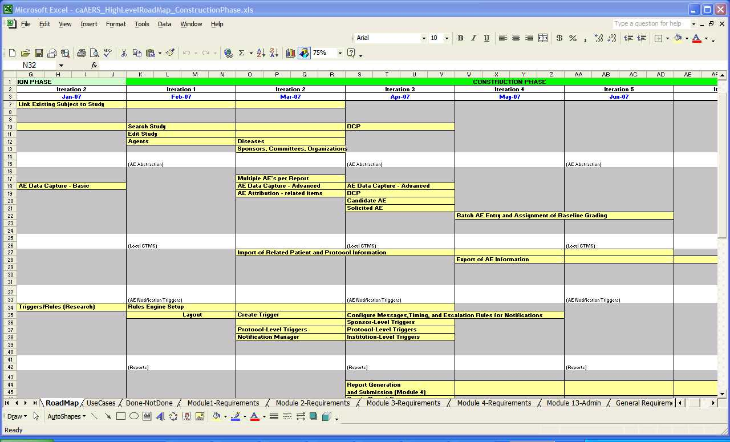
Construction Phase High-Level Roadmap

Slide 9
Upcoming Events
CCB
  1st: Monday, 3/12
Construction Phase Face-to-Face Meetings
  1st: Beginning of 3rd Iteration: Proposed Dates: Thursday, April 19 and Friday, April 20
  2nd: Beginning of 6th Iteration (early July)

Slide 10
Focus of Today’s Demo

Slide 11
Search and Edit Study
Search for Existing Study
  Short Title
  Long Title
  Description
  Precis
  Phase Code
Search on single or multiple criteria
Edit Existing Study
  Study Agents (Not Implemented)
  Audit/History (Not Implemented)

Slide 12
Study Agents
Study Agents
  Agent Name, NSC #, IND #, local ID # -- if no NSC#).
  User can create 0..* agents for the protocol.
  Database populated with CTEP list. http://ctep.cancer.gov/guidelines/codes.html#agent
  Allow users to search this list using name or NSC number.
  If desired agent is not found, allow user to create a new agent with a name and ID number. (NOT IMPLEMENTED)
  Allow optional entry of IND number -- this identifies the StudyAgent

Slide 13
Triggers/Notifications
Preview of draft user interface and functionality.

